Slide 1


CASE STUDY-3
ENERGY EFFICIENCEY IN SMART BUILDINGS

Slide 2
TEAM
MANOJKUMAR.M (TEAMLEADER-SAF_CP_TEAM-11807)
SURYA PRAKASH.P (TEAMLMEMBER-SAF_CP_TEAM-11807)
SEENIVASAN.T (TEAMMEMBER-SAF_CP_TEAM-11807)
VIJAYIMMANUVEL.V (TEAMMEMBER-SAF_CP_TEAM-11807)
THARUN.A (TEAMMEMBER-SAF_CP_TEAM-11807)

Slide 3
Content
Abstract
Problem Statement
Objective
Data Collection and Preparation
Proposed Solution (Methodology)
Model Performance Evaluation
Screenshots / Demonstration (video)
Future Scope
Conclusion
Notes:
Abstract
Problem Statement (Clearly define the challenge)
Objective (State your project's goal)
Background and Research (Discuss existing solutions, trends, and gaps)
Data Collection and Preparation (Focus on data sources, cleaning, and augmentation)
Proposed Solution (Methodology)
Model Architecture (e.g., CNN, U-Net, YOLOv5)
Key Techniques (e.g., Transfer Learning, Image Augmentation)
Model Performance Evaluation
Metrics (Accuracy, Precision, Recall, IoU, etc.)
Graphs (Confusion Matrix, ROC Curve, etc.)
Screenshots / Demonstration (Visual proof of system functionality)
Future Scope (Improvements, scalability, and integration ideas)
Conclusion (Summarize results and impact)
Q&A Session

Slide 4
Abstract
Smart buildings leverage advanced technologies, such as sensors, automation, and data analytics, to optimize energy consumption and reduce environmental impact.
This report explores the energy efficiency strategies employed in smart buildings, their advantages, challenges, and future scope.
The increasing demand for energy efficiency has made smart buildings a crucial aspect of sustainable architecture.
Through the analysis of existing models and technologies, this study provides insights into the current state of energy-efficient buildings, and proposes solutions for enhancing their performance while minimizing energy waste.

Slide 5
Problem Statement
The construction and operation of buildings account for a significant portion of global energy consumption and carbon emissions.
With urban populations growing, there is an urgent need to develop and implement energy-efficient solutions in buildings.
Traditional buildings, without automation and advanced control systems, consume energy inefficiently, leading to unnecessary waste, high operational costs, and increased environmental footprints.
There is a lack of integrated systems that allow for the real-time monitoring and optimization of energy consumption in existing buildings, which exacerbates these issues.

Slide 6
Objective
The primary objective of this study is to explore the role of smart building technologies in enhancing energy efficiency. Specific objectives include:
To identify the key technologies enabling energy efficiency in smart buildings.
To propose a methodology for integrating energy-efficient solutions in new and retrofitted buildings.
To evaluate the performance of smart building systems and assess their impact on energy consumption.
To explore the challenges faced in implementing these solutions and provide recommendations for overcoming them.

Slide 7
Data Collection and Preparation
Data collection for this study involves gathering information from various sources, including:
Energy Usage Data: Real-time consumption data from smart meters, sensors, and building management systems (BMS).
Building Characteristics: Information about the building’s structure, insulation, HVAC systems, lighting, and renewable energy installations.
Environmental Factors: Weather data to understand the external impact on building energy needs.
Case Studies: Existing smart building implementations and their performance outcomes.
Data will be prepared by cleaning, normalizing, and organizing it into a suitable format for analysis. This may involve the aggregation of sensor data, energy consumption records, and building performance data into databases or spreadsheets for easier processing.

Slide 8
Proposed Solution (Methodology)
The proposed methodology for enhancing energy efficiency in smart buildings involves:
A synthetic dataset was created simulating daily energy consumption over two years (730 days). Features included:
Occupancy (number of people)
Temperature (in °C)
Humidity (in %)
Weather Conditions (categorical, though not used in the model)
Energy Consumption (target variable, in kWh)
From this dataset:
Only numerical features were selected for model training (occupancy, temperature, humidity).
The data was split into training and testing sets using an 80-20 ratio.

Slide 9
Model Performance Evaluation
To evaluate the effectiveness of the proposed energy-efficient solutions, the following metrics will be used:
Energy Consumption Reduction: Compare energy consumption before and after implementing smart systems.
Cost Savings: Analyze the reduction in operational costs due to optimized energy use.
Environmental Impact: Measure the reduction in carbon emissions based on the energy savings.
Occupant Comfort and Satisfaction: Survey building occupants to assess comfort levels in terms of temperature, lighting, and overall environment quality.
ROI (Return on Investment): Assess the payback period for implementing smart energy solutions based on energy savings and cost reduction.
Performance evaluation will involve both simulation models and real-world case studies to provide a comprehensive analysis.

Slide 10
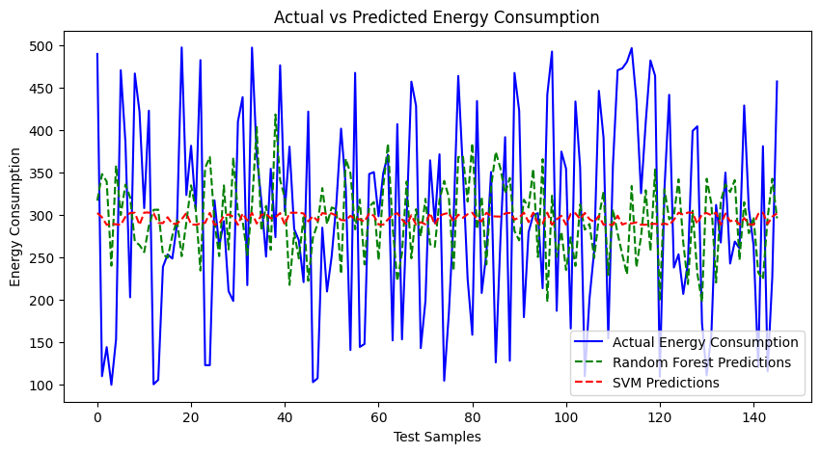
Screenshots / Demonstration (video)
GitHub Link: https://github.com/Mano6374/CASE-STUDY_3-S4F_CP_TEAM_11807

Slide 11
Future Scope
The future scope of energy-efficient smart buildings is promising, with the following trends:
Advanced AI and Machine Learning: Future smart buildings will incorporate even more sophisticated AI to predict energy consumption patterns and optimize operations dynamically.
Integration with Smart Grids: Buildings will not only consume energy but also contribute to the energy grid by sending excess energy from renewable sources back to the grid.
Zero-Energy Buildings: The development of buildings that generate as much energy as they consume through the use of advanced renewable energy technologies and energy-efficient designs.
Sustainability Regulations: As regulations around sustainability become stricter, energy-efficient smart buildings will become the norm, not the exception.
Blockchain for Energy Transactions: Blockchain could enable secure, transparent, and efficient energy transactions in decentralized energy markets.

Slide 12
CASE STUDY-3
QUESTIONS & ANSWER

Slide 13
How can Al be used to identify inefficiencies in energy consumption in smart buildings?
AI for Identifying Inefficiencies in Smart Buildings: AI can analyze data from IoT sensors, smart meters, and building management systems to detect patterns of energy waste.
For example, it can identify inefficient HVAC systems, lighting left on in unoccupied spaces, or suboptimal equipment scheduling.
Machine learning algorithms can also predict peak energy usage and suggest adjustments to reduce consumption.
2. Build a model to predict the energy consumption of the building based on occupancy and weather data?
Model to Predict Energy Consumption: A machine learning model can be built using historical energy consumption data, occupancy levels, and weather conditions.
Algorithms like Random Forest, Gradient Boosting, or Neural Networks are effective for such tasks.
The model would require preprocessing steps like data cleaning, feature scaling, and splitting into training and testing datasets.

Slide 14
3. Suggest additional features that could be incorporated into the model to improve its accuracy?
Additional Features for Improved Accuracy: To enhance the model's accuracy, you could incorporate:
Real-time occupancy data from motion sensors.
Appliance usage patterns.
Building insulation quality.
External factors like energy prices or grid demand.
4. What steps can building managers take based on the model's predictions to reduce energy consumption?
Steps for Building Managers: Based on the model's predictions, building managers can:
Optimize HVAC and lighting schedules.
Upgrade to energy-efficient appliances.
Implement predictive maintenance for equipment.
Educate occupants on energy-saving practices.

Slide 15
5. How can Al-driven solutions contribute to achieving net-zero energy buildings?
AI-Driven Solutions for Net-Zero Energy Buildings: AI can optimize energy use by integrating renewable energy sources, managing energy storage, and balancing supply and demand in real-time.
Predictive analytics can forecast energy needs and adjust systems dynamically.
AI also supports retrofitting strategies by identifying areas for improvement, such as insulation upgrades or solar panel installations.
Let me know if you'd like to dive deeper into any of these points!

Slide 16
Conclusion
Energy-efficient smart buildings offer a solution to the challenges posed by high energy consumption in the built environment.
By leveraging technologies like automation, sensors, and renewable energy sources, these buildings can significantly reduce energy consumption, cut operational costs, and contribute to a more sustainable future.
However, challenges such as high initial costs, integration complexity, and data privacy must be addressed to fully realize the potential of smart buildings.
The future of smart buildings lies in continuous advancements in AI, IoT, and renewable energy integration, leading to the development of zero-energy buildings and smarter urban infrastructure.

